Slide 1




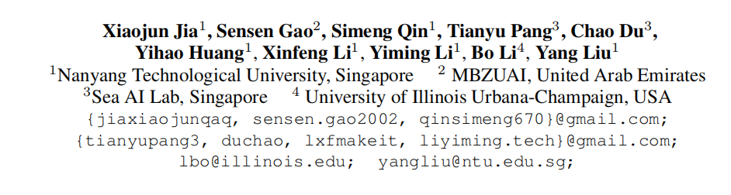



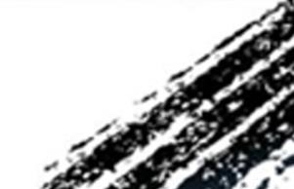

ATAI
Advanced Technique of Artificial Intelligence
ATAI
ChongqingUniversity _{AdvancedTechniqueof}
of Technology Artificial Intelligence
Chongqing University of
Technology
Chongqing University ^{ATAI}
_{of Technology} Advanced Techniqueof
Artificial Intelligence
Chongqing University of Technology
Chongqing University of Technology
Adversarial Attacks against Closed-Source MLLMs
via Feature Optimal Alignment
Code: https://github.com/jiaxiaojunQAQ/FOA-Attack
—NeurIPS_2025
Reported by Cong Sheng
1

Slide 2
ATAI
Advanced Technique of Artificial Intelligence
ATAI
ChongqingUniversity _{AdvancedTechniqueof}
of Technology Artificial Intelligence
Chongqing University of
Technology
Chongqing University ^{ATAI}
_{of Technology} Advanced Techniqueof
Artificial Intelligence
Chongqing University of Technology
Chongqing University of Technology
Motivation
Research background: MLLMs are vulnerable to adversarial examples , as they inherit the adversarial vulnerability of vision encoders.
Current adversarial attacks’ key challenges:
1) Limited Transferability: Existing adversarial attacks primarily align global image features, neglecting fine-grained local structures. This leads to overfitting on surrogate models and poor transferability to unseen, especially closed-source, MLLMs..
2)Weak Feature Alignment: Relying solely on global feature matching (e.g., CLS token) results in weak semantic alignment, generating perturbations that are less generalizable and fail to deceive robust models effectively.
3)Inefficient Ensembles: While ensemble methods improve transferability, using static, uniform weights for different models causes the optimization to favor easier tasks, limiting overall attack performance.
Goal: Develop a highly transferable attack via optimal global-local feature alignment and dynamic model ensembling to effectively target both open and closed-source MLLMs.

Slide 3
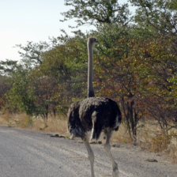
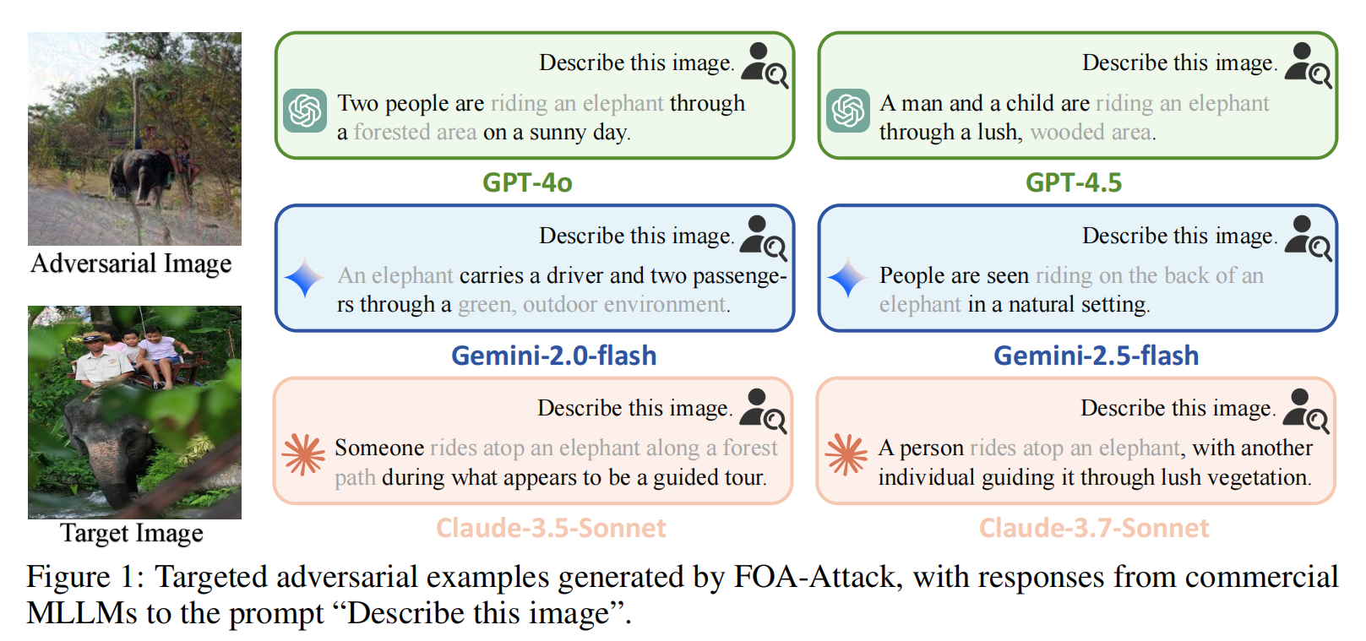
ATAI
Advanced Technique of Artificial Intelligence
ATAI
ChongqingUniversity _{AdvancedTechniqueof}
of Technology Artificial Intelligence
Chongqing University of
Technology
Chongqing University ^{ATAI}
_{of Technology} Advanced Techniqueof
Artificial Intelligence
Chongqing University of Technology
Chongqing University of Technology
Overview
Nature Image

Slide 4
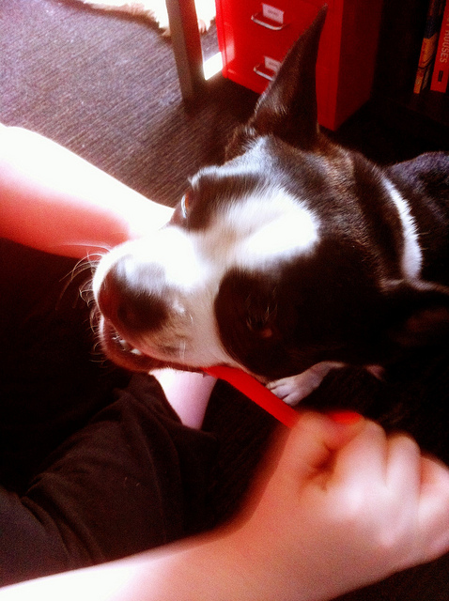
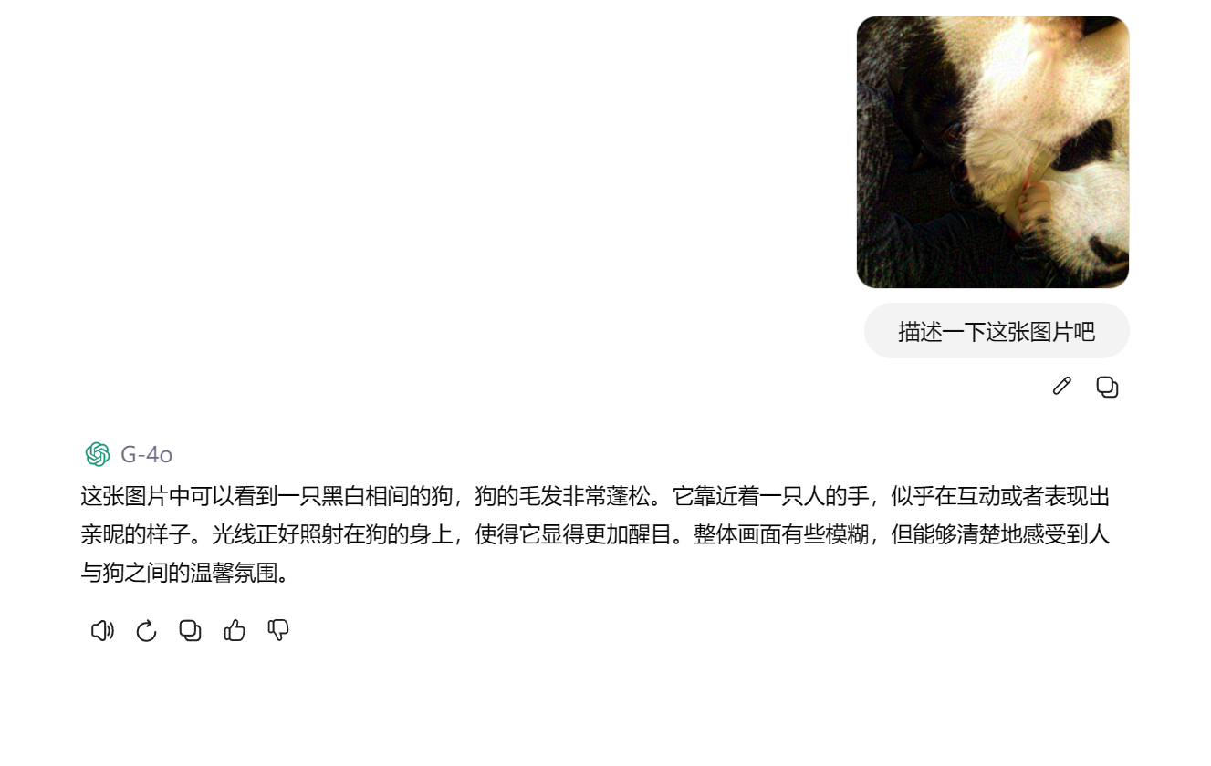
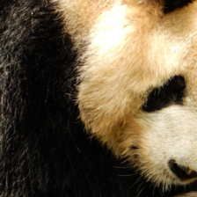
ATAI
Advanced Technique of Artificial Intelligence
ATAI
ChongqingUniversity _{AdvancedTechniqueof}
of Technology Artificial Intelligence
Chongqing University of
Technology
Chongqing University ^{ATAI}
_{of Technology} Advanced Techniqueof
Artificial Intelligence
Chongqing University of Technology
Chongqing University of Technology
Overview

Slide 5
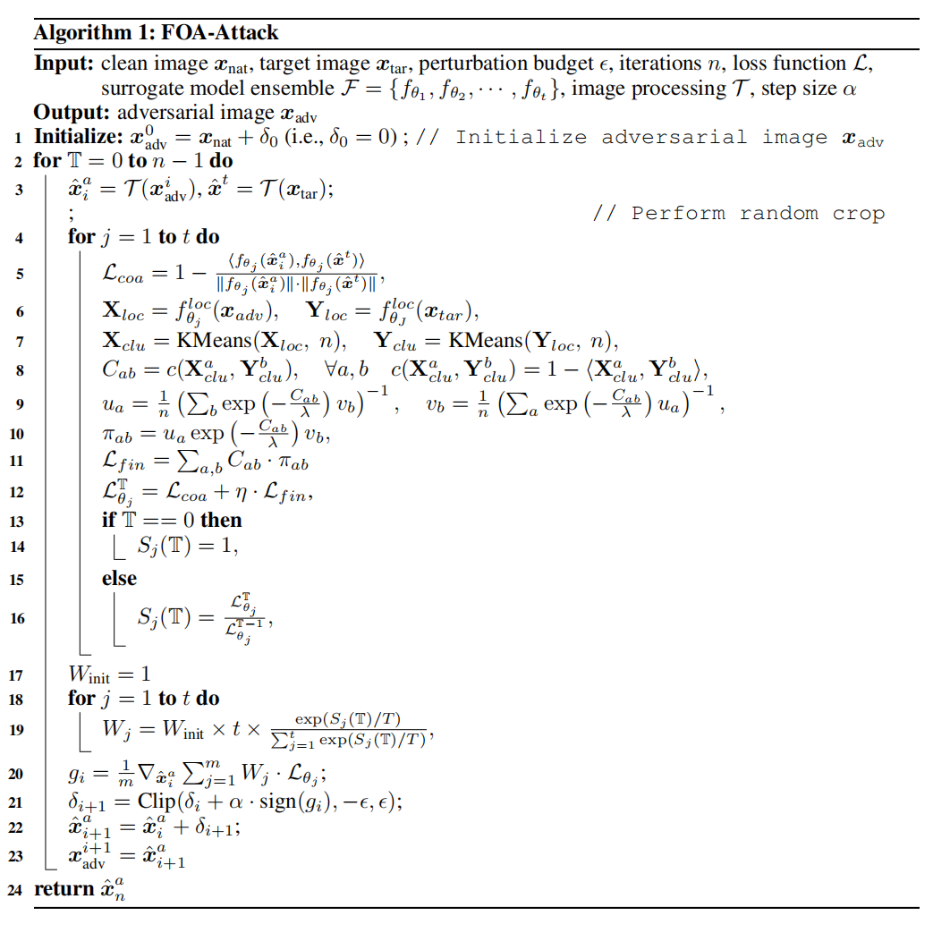
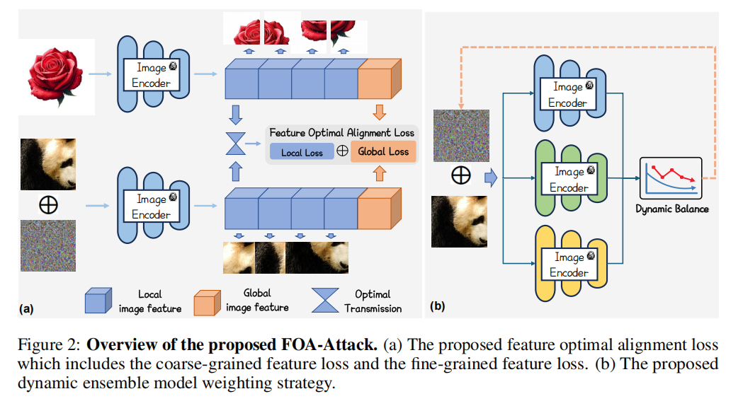
ATAI
Advanced Technique of Artificial Intelligence
ATAI
ChongqingUniversity _{AdvancedTechniqueof}
of Technology Artificial Intelligence
Chongqing University of
Technology
Chongqing University ^{ATAI}
_{of Technology} Advanced Techniqueof
Artificial Intelligence
Chongqing University of Technology
Chongqing University of Technology
Overview

Slide 6
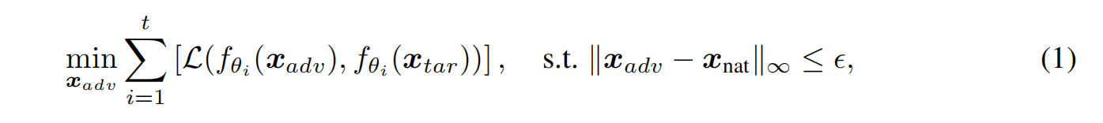



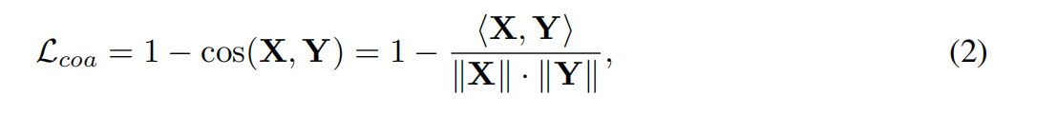
ATAI
Advanced Technique of Artificial Intelligence
ATAI
ChongqingUniversity _{AdvancedTechniqueof}
of Technology Artificial Intelligence
Chongqing University of
Technology
Chongqing University ^{ATAI}
_{of Technology} Advanced Techniqueof
Artificial Intelligence
Chongqing University of Technology
Chongqing University of Technology
Method

Slide 7
ATAI
Advanced Technique of Artificial Intelligence
ATAI
ChongqingUniversity _{AdvancedTechniqueof}
of Technology Artificial Intelligence
Chongqing University of
Technology
Chongqing University ^{ATAI}
_{of Technology} Advanced Techniqueof
Artificial Intelligence
Chongqing University of Technology
Chongqing University of Technology
Method

Slide 8
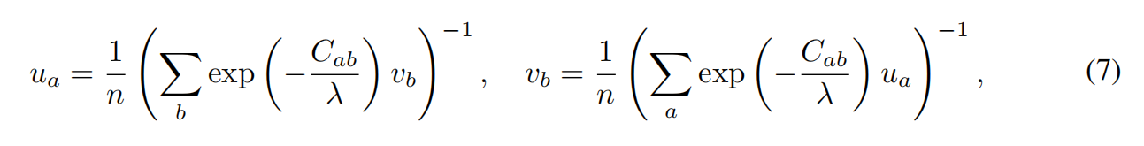
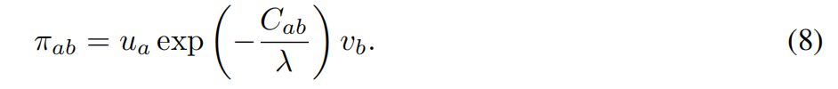
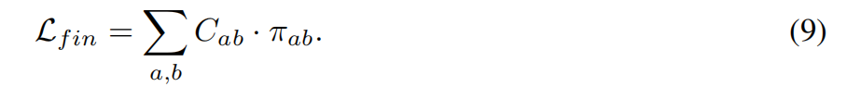
ATAI
Advanced Technique of Artificial Intelligence
ATAI
ChongqingUniversity _{AdvancedTechniqueof}
of Technology Artificial Intelligence
Chongqing University of
Technology
Chongqing University ^{ATAI}
_{of Technology} Advanced Techniqueof
Artificial Intelligence
Chongqing University of Technology
Chongqing University of Technology
Method

Slide 9
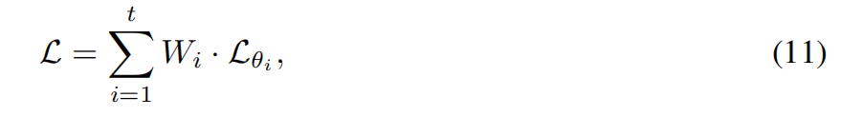
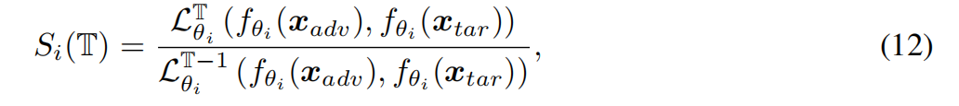
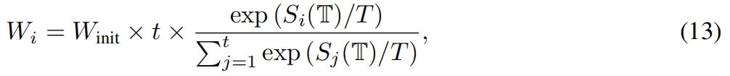
ATAI
Advanced Technique of Artificial Intelligence
ATAI
ChongqingUniversity _{AdvancedTechniqueof}
of Technology Artificial Intelligence
Chongqing University of
Technology
Chongqing University ^{ATAI}
_{of Technology} Advanced Techniqueof
Artificial Intelligence
Chongqing University of Technology
Chongqing University of Technology
Method

Slide 10
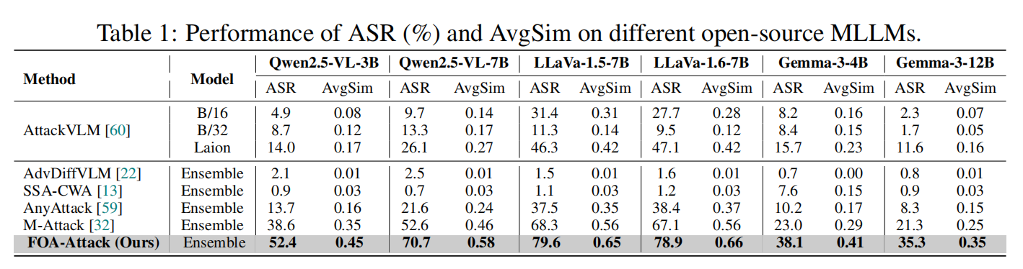
ATAI
Advanced Technique of Artificial Intelligence
ATAI
ChongqingUniversity _{AdvancedTechniqueof}
of Technology Artificial Intelligence
Chongqing University of
Technology
Chongqing University ^{ATAI}
_{of Technology} Advanced Techniqueof
Artificial Intelligence
Chongqing University of Technology
Chongqing University of Technology
Experiments

Slide 11
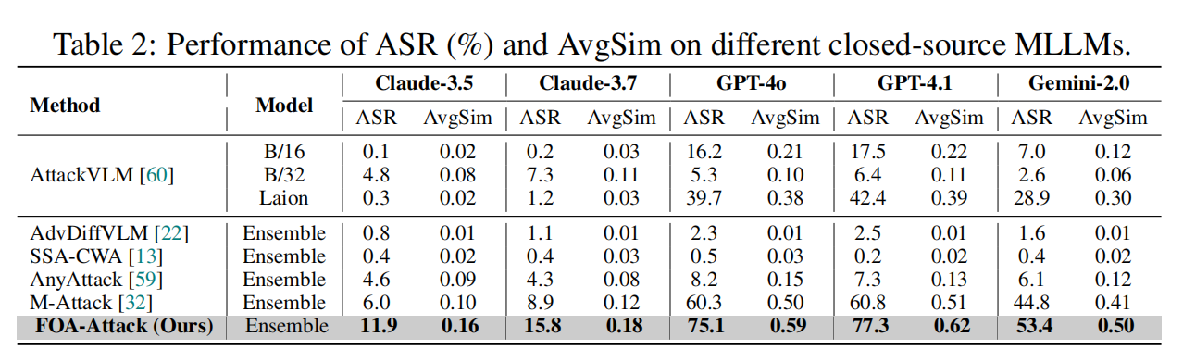
ATAI
Advanced Technique of Artificial Intelligence
ATAI
ChongqingUniversity _{AdvancedTechniqueof}
of Technology Artificial Intelligence
Chongqing University of
Technology
Chongqing University ^{ATAI}
_{of Technology} Advanced Techniqueof
Artificial Intelligence
Chongqing University of Technology
Chongqing University of Technology
Experiments

Slide 12

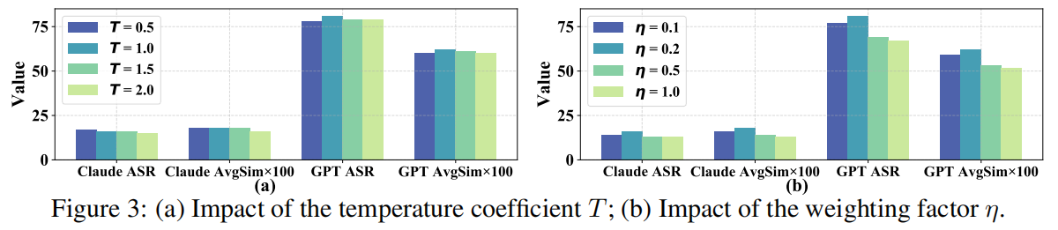
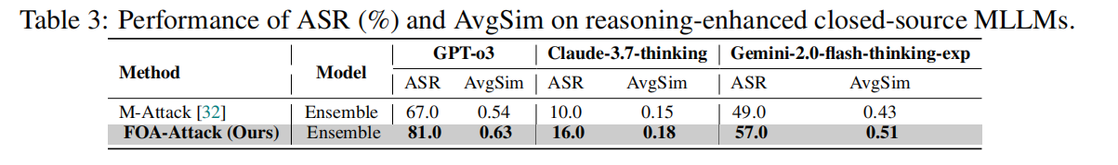
ATAI
Advanced Technique of Artificial Intelligence
ATAI
ChongqingUniversity _{AdvancedTechniqueof}
of Technology Artificial Intelligence
Chongqing University of
Technology
Chongqing University ^{ATAI}
_{of Technology} Advanced Techniqueof
Artificial Intelligence
Chongqing University of Technology
Chongqing University of Technology

Slide 13
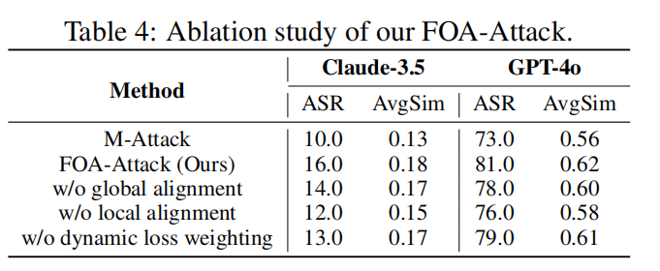
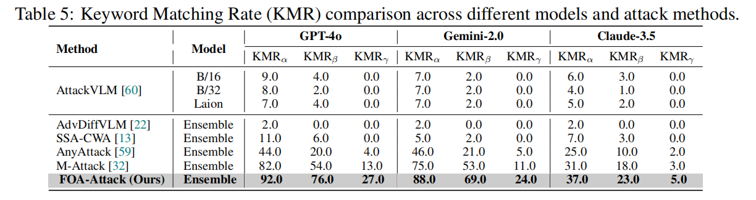
ATAI
Advanced Technique of Artificial Intelligence
ATAI
ChongqingUniversity _{AdvancedTechniqueof}
of Technology Artificial Intelligence
Chongqing University of
Technology
Chongqing University ^{ATAI}
_{of Technology} Advanced Techniqueof
Artificial Intelligence
Chongqing University of Technology
Chongqing University of Technology

Slide 14
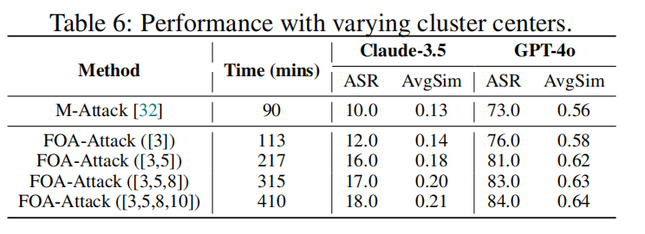
ATAI
Advanced Technique of Artificial Intelligence
ATAI
ChongqingUniversity _{AdvancedTechniqueof}
of Technology Artificial Intelligence
Chongqing University of
Technology
Chongqing University ^{ATAI}
_{of Technology} Advanced Techniqueof
Artificial Intelligence
Chongqing University of Technology
Chongqing University of Technology

